Slide 1




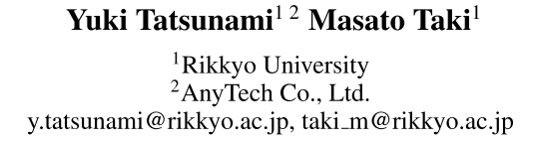





ATAI
Advanced Techniqueof Artificial Intelligence
ATAI
ChongqingUniversity _{AdvancedTechniqueof}
of Technology Artificial Intelligence
Chongqing University of
Technology
Chongqing University ^{ATAI}
_{of Technology} Advanced Techniqueof
Artificial Intelligence
Chongqing University of Technology
Chongqing University of Technology
FFT-based Dynamic Token Mixer for Vision
FFT-based Dynamic Token Mixer for Vision
Code: https://github.com/okojoalg/dfformer
—— AAAI 2024
Reported by Tingting Zhang
1

Slide 2

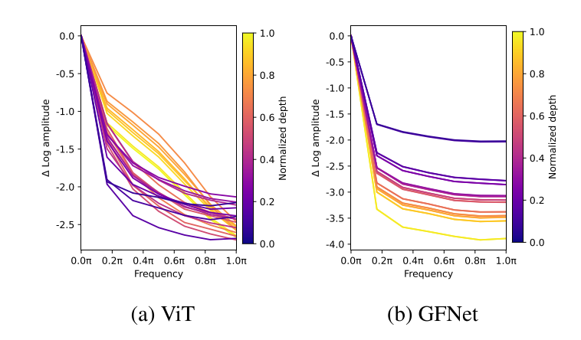
ATAI
AdvancedTechniqueof
Artificial Intelligence
ATAI
ChongqingUniversity _{AdvancedTechniqueof}
of Technology Artificial Intelligence
ChongqingUniversity of Technology
Motivation
While MHSA modules have been a success, it has faced challenges, especially in aspects of quadratic computational complexity due to global attention design.
Notes:
1. 虽然多头自注意力（MHSA）模块有效，但其计算复杂度随着输入图像分辨率的增加而急剧上升，特别是在语义分割等密集任务中。
2. GFNet架构作为ViT的衍生物，具备降低计算复杂度和更易训练的优点。它利用全局滤波器在频域内调整特征，从而降低计算成本。

Slide 3

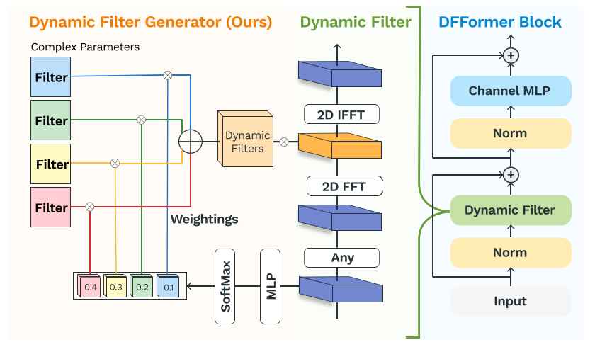
ChongqingUniversity of Technology
ATAI
AdvancedTechniqueof
Artificial Intelligence
ATAI
ChongqingUniversity _{AdvancedTechniqueof}
of Technology Artificial Intelligence
Overview

Slide 4

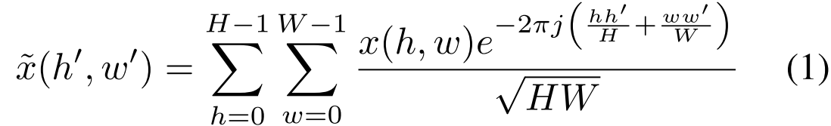
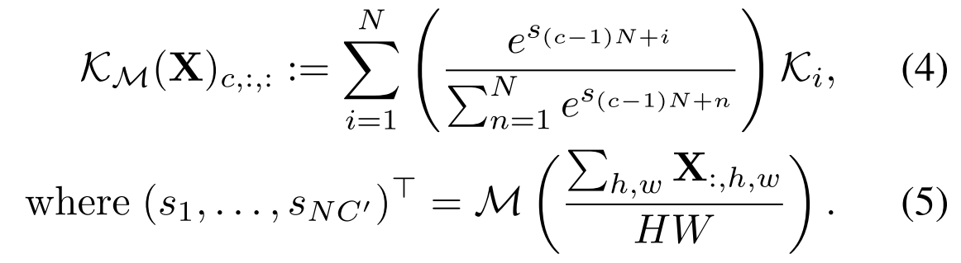
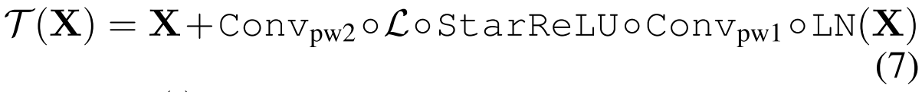
ChongqingUniversity of Technology
ATAI
AdvancedTechniqueof
Artificial Intelligence
ATAI
ChongqingUniversity _{AdvancedTechniqueof}
of Technology Artificial Intelligence
Method

Slide 5

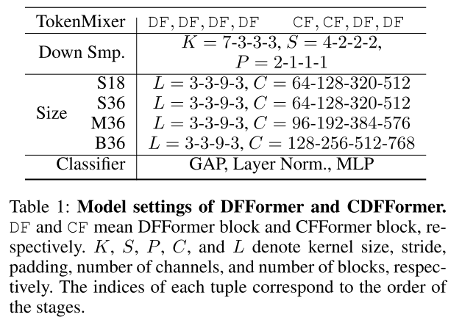
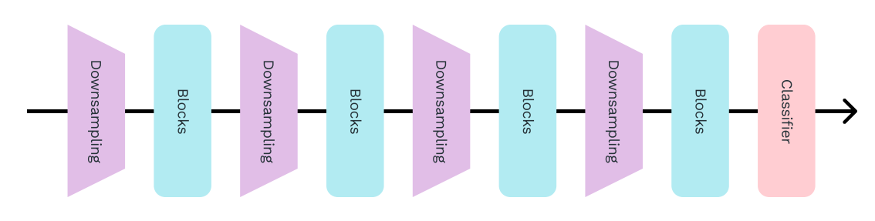
ATAI
AdvancedTechniqueof
Artificial Intelligence
ATAI
ChongqingUniversity _{AdvancedTechniqueof}
of Technology Artificial Intelligence
ChongqingUniversity of Technology
Experiments

Slide 6
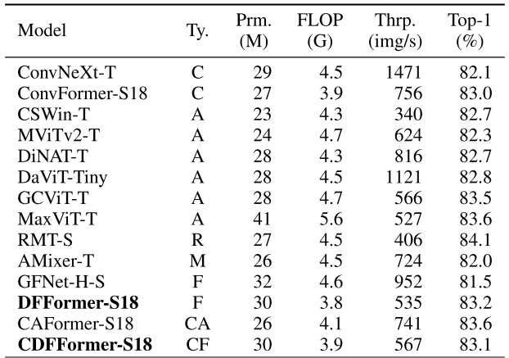

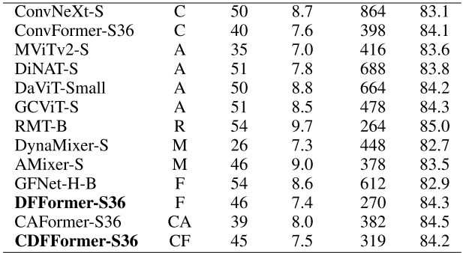
ATAI
AdvancedTechniqueof
Artificial Intelligence
ATAI
ChongqingUniversity _{AdvancedTechniqueof}
of Technology Artificial Intelligence
ChongqingUniversity of Technology
Experiments
The full names of types are C is Convolution, A is Attention, R is Retention, M is MLP, F is FFT, CA is a hybrid of Convolution and Attention, and a hybrid of Convolution and FFT, respectively.

Slide 7
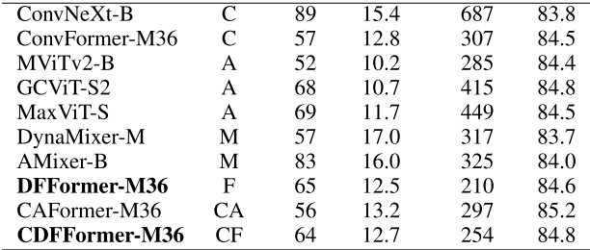
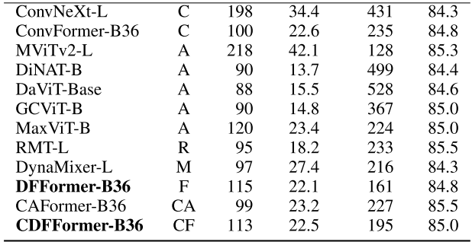
ATAI
AdvancedTechniqueof
Artificial Intelligence
ATAI
ChongqingUniversity _{AdvancedTechniqueof}
of Technology Artificial Intelligence
ChongqingUniversity of Technology
Experiments
The full names of types are C is Convolution, A is Attention, R is Retention, M is MLP, F is FFT, CA is a hybrid of Convolution and Attention, and a hybrid of Convolution and FFT, respectively.

Slide 8
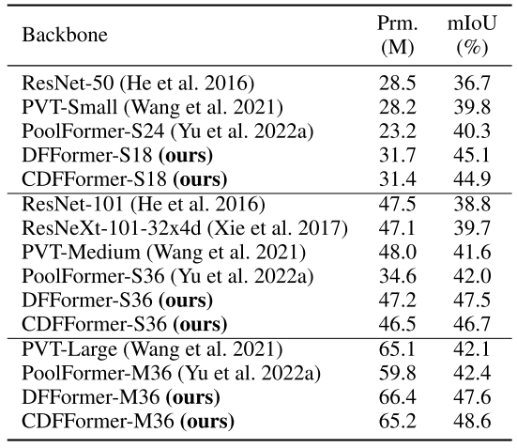
ATAI
AdvancedTechniqueof
Artificial Intelligence
ATAI
ChongqingUniversity _{AdvancedTechniqueof}
of Technology Artificial Intelligence
ChongqingUniversity of Technology
Experiments

Slide 9
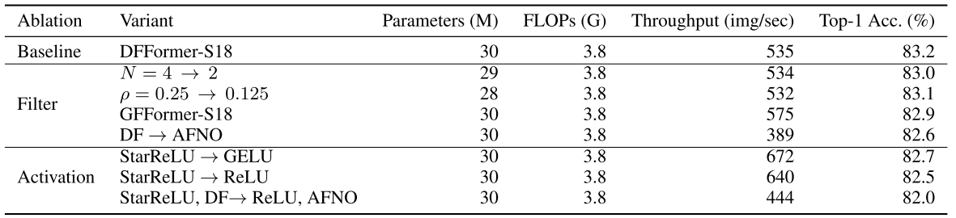
ATAI
AdvancedTechniqueof
Artificial Intelligence
ATAI
ChongqingUniversity _{AdvancedTechniqueof}
of Technology Artificial Intelligence
ChongqingUniversity of Technology
Experiments

Slide 10
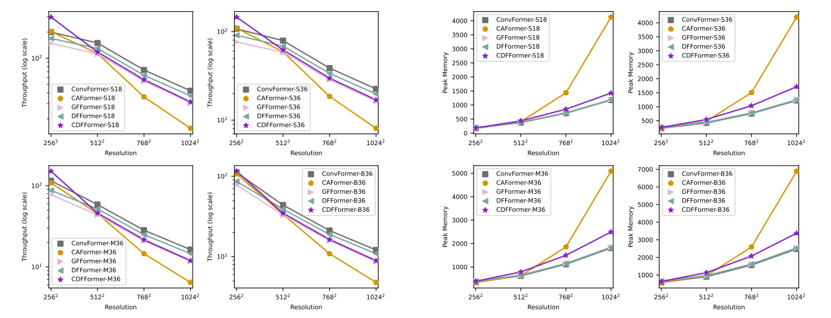
ATAI
AdvancedTechniqueof
Artificial Intelligence
ATAI
ChongqingUniversity _{AdvancedTechniqueof}
of Technology Artificial Intelligence
ChongqingUniversity of Technology
Experiments
Advantages at Higher Resolutions

Slide 11
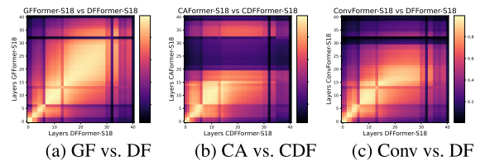
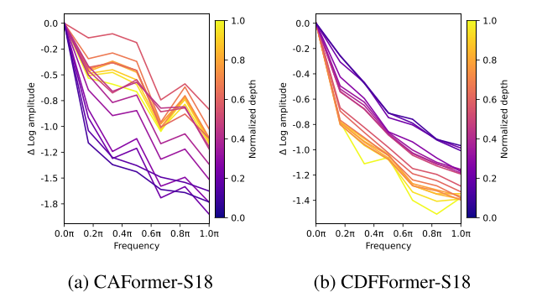
ATAI
AdvancedTechniqueof
Artificial Intelligence
ATAI
ChongqingUniversity _{AdvancedTechniqueof}
of Technology Artificial Intelligence
ChongqingUniversity of Technology
Experiments
Representational Similarities

Slide 12
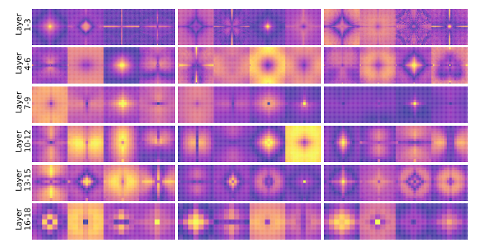
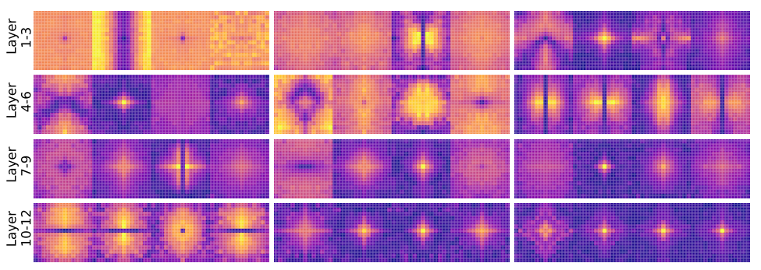
ATAI
AdvancedTechniqueof
Artificial Intelligence
ATAI
ChongqingUniversity _{AdvancedTechniqueof}
of Technology Artificial Intelligence
ChongqingUniversity of Technology
Experiments
DFFormer-S18
GFNet-Ti

Slide 13


ChongqingUniversity of Technology
ATAI
AdvancedTechniqueof
Artificial Intelligence
ATAI
ChongqingUniversity _{AdvancedTechniqueof}
of Technology Artificial Intelligence
Thanks!

